Slide 1
Mental Health & Substance use: Overcoming to be our best self
Presented by: BTheOne Youth Ambassadors

Slide 2
BTHEONE overview
BTHEONE is a movement to empower young people to use their voices on topics that impact them. The program was initially started to address suicide prevention but has grown to address substance use and misuse as well as overall mental wellness. BTheOne seeks to grow it members by providing leadership opportunities, advocacy opportunities, in addition to opportunities for community service.

Slide 3
BTHEONE
Mission: BTheOne Youth Ambassadors Program is designed to be a Youth led, but adult guided program for Montgomery County youth to increase leadership skills, develop advocacy skills and prepare youth to make a difference in the community on social and public health issues.
Vision: Is to help youth reach their fullest potential through creative and innovative opportunities to impact their community.

Slide 4
Agenda
BTheOne Overview
Stress and Time Management
Ways to Destress
Fentanyl/Opioids
Resource in Schools and Community
988
Getting Involved
Panel Discussion
Q&A

Slide 5
Stress and time Management

Slide 6
sources of stress for teens
School demands and frustrations
Negative thoughts or feelings about themselves
Changes in their bodies
Problems with friends and/or peers at school
Unsafe living environment/neighborhood
Separation or divorce of parents
Chronic illness or severe problems in the family
Death of a loved one
Moving or changing schools
Taking on too many activities or having too high expectations
Family financial problems

Slide 7
Stress Overload
When we are overloaded with stress, it can lead to anxiety, withdrawal, aggression, physical illness, or poor coping skills such as drug and/or alcohol use.
WHAT LIES BEHIND US AND WHAT LIES BEFORE US ARE TINY MATTERS COMPARED TO WHAT LIES WITHIN US.
Ralph Waldo Emerson

Slide 8
What is Effective tIme Management?
Effective use of your time that allows you to plan your days such that you are able to finish your work with less effort and make the most of the limited time you’ve got.
Image Source: Forbes.com

Slide 9
Why is this IMportant?
When we are lacking good time management skills, we are more likely to:
Miss project deadlines
Produce low-quality Work
Disrupt our work-life or school-life balance
Experience burnout
Become overstressed

Slide 10
Effective Time Management Strategies
Know how you spend your time
Set priorities
Use a planning tool
Get organized
Schedule appropriately
Delegate: Get help from others
Stop procrastinating
Manage Time-Wasters
“The best thing about the future is that it comes one day at a time.” - Abraham Lincoln

Slide 11
Ways to Destress
It's normal to feel stress, according to the 2017 APA Stress Survey, 83% of teens identified school as a major stressor.Stress is a normal thing, everyone experiences it. But too much stress is not a good thing. So here are 3 steps to help you out:
SLEEP
EXERCIZE
MAKING TIME TO DO FUN THINGS

Slide 12
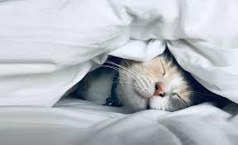
Sleep
The National Sleeping Foundation found that HS students need 8-10 hours of sleep. Catching up on lost sleep also isn't a healthy habit, it doesn't help with sleep during the weekdays. Ways to help sleep long enough is steps like drinking less caffeine, turning devices off an hour before bed, and establishing a sleep schedule.

Slide 13
2. Exercise
Studies show that exercising is very effective at reducing fatigue, improving alertness and concentration, and at enhancing overall cognitive performance. This can be helpful when stress has lost your energy to concentrate. Exercise and other physical activities produce endorphins- chemicals in the brain that act as natural painkillers- and also improve your ability to sleep, which in turn reduces stress.

Slide 14
3. Making Time to do Fun Things
Lastly, doing enjoyable or relaxing activities trigger your brain to release neurochemicals related to happiness, such as dopamine and serotonin. These chemicals can counteract more uncomfortable feelings of hopelessness and stress. So go do something that allows you to relax and enjoy the moment, without worrying about the next project that is due.

Slide 15
Fentanyl/Opioids

Slide 16
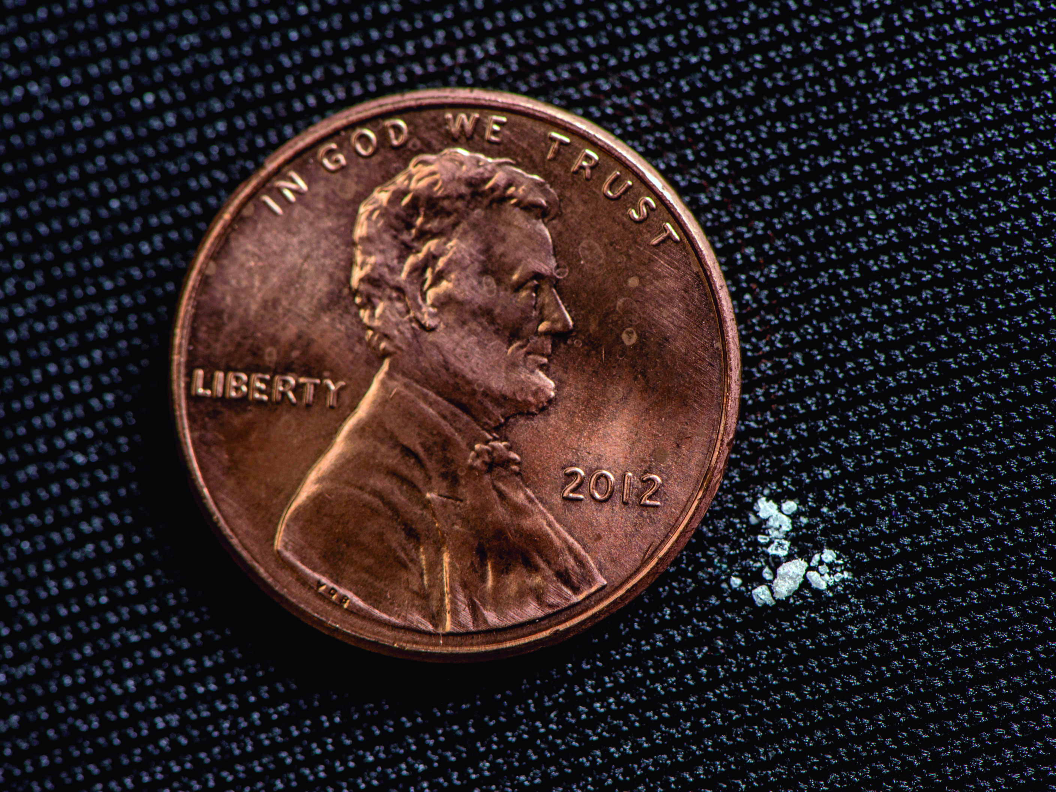
Fentanyl/Opioids in Montgomery County
Montgomery County is facing an significant rise in youth under 17 emergency room visits that are opioid related caused by fentanyl, an extremely deadly opioid that is often laced into pills and powders.
Which has impacted a lot of our peers across the county.

Slide 17
What can we do
Know the risks about these drugs
Learn the signs of an overdose
Call 911 if a friend or someone you know is overdosing as you will be protected under the Good Samaritan Law
Carry and get trained on how to use Naloxone
Get involved to help educate JOIN BTheOne Youth Ambassador Program

Slide 18
Where to Go? Resources

Slide 19
Resources at School
You can visit your counselor during school or you can set an appointment to see them the next day if you are out of school.
Use your schools mental health supports website
Apps such as the Calm App, go noodle, Everymind

Slide 20
Community Resources
Montgomery County Crisis Center- 240-777-4000
The Landing Adolescent Clubhouse -301-461-3477
Journeys-301-294-4015
Call/Text 988

Slide 21
988 Suicide and Crisis Lifeline Info
What is it?
The 988 Suicide & Crisis Lifelineoffers 24/7 call, text and chat access to trained crisis counselors who can help people experiencing suicidal, substance use, and/or mental health crisis, or any other kind of emotional distress.
What happens when I call 988?
When calling 988, callers first hear a greeting message while their call is routed to the local Lifeline network crisis center. A trained crisis counselor answers the phone, listens to the caller, understands how their problem is affecting them, provides support, and shares resources if needed.
988 vs 911
988 provides easier access to the Lifeline network and related crisis resources, which are distinct from the public safety purposes of 911 (where the focus is on dispatching Emergency Medical Services, fire and police as needed).
Is the 988 lifeline a free service?
Yes, the Lifeline responds 24/7 to calls (multiple languages), chats, or texts (English only) from anyone who needs mental health-related or suicide crisis support and connects them with trained crisis counselors with no charge, although standard data rates may apply.

Slide 22
Get involved

Slide 23
Getting involved
Youth advocacy is the process of identifying, understanding, and addressing issues that are important to young people.
By advocating for kids in school, communities, and society at large, we can empower our peers to take on responsibility for their own safety and well-being.
You can take a stand on: Climate Change, mental health/substance use, education, gender equality.
important to remember that the best advocacy will be one that you're passionate about

Slide 24
Follow us on Instagram @mc_b_the_one Join us by emailing “I’m Interested” to YAP@montgomerycountymd.gov

